Slide 2
Quinn Aerospace
Abbreviated Business Model

Slide 3
What is a Pressure Foil?
A Pressure Foil is a rotating thrust-producing apparatus that uses a unique method of force production as described in U.S. patent 5,328,333.
The force generated via this method can be used to propel cars, ships, trains, and aircraft.

Slide 4
U.S. Patent 5,328,333 Abstract​
Rotating thrust-producing apparatus
Abstract -- A circular foil connectable to a source of power for producing thrust in an axial direction when rotated, includes a flat circular plate and a plurality of closely spaced-apart fins fixed to an upper face of the circular plate, which occupy substantially the entire peripheral portion of the plate. A cylindrical hoop is fixed to the plate adjacent to radially inwardly extending edges of the fins to prevent fluid disposed adjacent to the circular plate and radially inwardly of the fins, from flowing radially outwardly and into the space between the fins as the circular foil is rotated. The foil is rotated at a sufficient speed to discharge fluid molecules from spaces between the fins at a rate faster than they can be replenished. This creates an imbalance of fluid pressure on the first side of the foil relative to an opposite second side thereof. As a result the circular foil moves in the direction of the deficit.

Slide 5
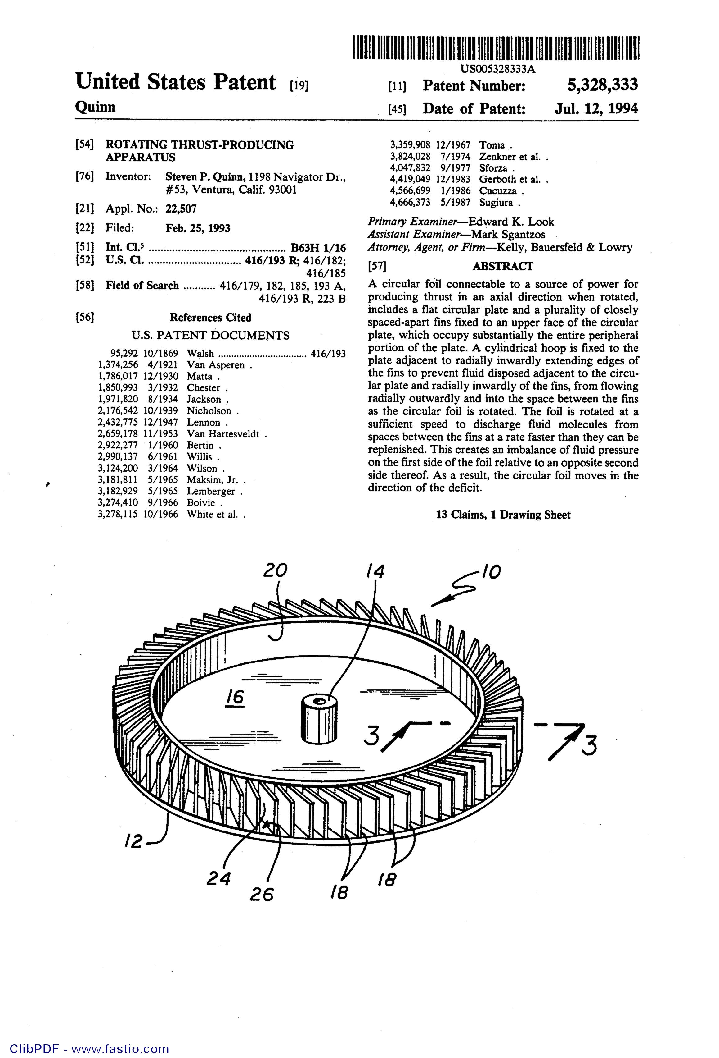
U.S. Patent 5,328,333​

Slide 6
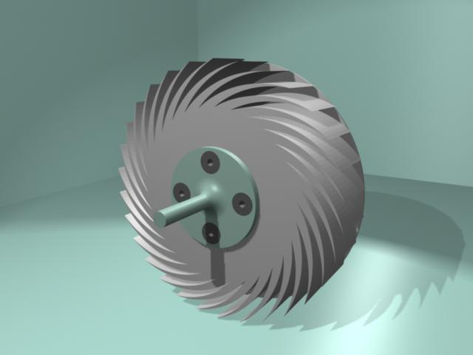
Pressure Foil – Front (fig. A)

Slide 7
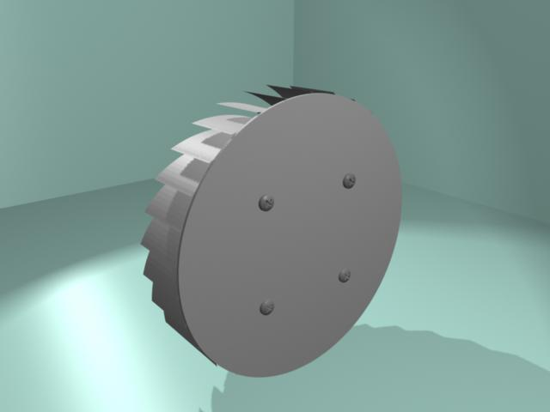
Pressure Foil – Back (fig. B)

Slide 8
Why is this method better?
More fuel efficient than jet or rocket propulsion
No propeller slippage (propeller aircraft)
No retreating blade stall (helicopters)
Direct propulsion (automobiles)
Smaller diameter rotor

Slide 9
More Fuel Efficient than Jet or Rocket Propulsion
The Thrust Specific Energy Consumption (TSEC in kJ/kN-s) for typical jet and rocket thrusters is 946 and 29300, respectively.
The Thrust Specific Energy Consumption (TSEC in kJ/kN-s) for a typical pressure-foil thruster is 148. This means that pressure-foil propulsion is about 7 times more fuel efficient than jets, and about 200 times more fuel efficient than rockets.
​

Slide 10
No Propeller Slippage
Conventional propellers begin to slip through the air at a certain rotational speed thus losing thrust on the propeller blades beyond a limiting RPM.
Pressure Foils do not have this limitation because rarefaction of the air is the goal. That is, the Pressure Foil relies on evacuation of air to create force, not on the pushing of air to create reaction force as in conventional propellers.

Slide 11
No Retreating Blade Stall
Retreating Blade Stall occurs on all helicopters at a certain forward speed of the helicopter that matches the backward speed of the retreating blade. This causes the retreating blade to stall and lose lift.
The Pressure Foil has no such limitation because the lift is equal around the entire periphery regardless of the forward air speed.

Slide 12
Direct Propulsion
All automobiles rely on tires pushing against the road to provide force. In rain, mud, snow, and ice this is not the best method to propel a car forward because of poor traction.
The Pressure Foil pushes the car directly, similar to pushing an aircraft, thus eliminating the need for transmission systems.

Slide 13
Smaller Rotor Diameter
Standard air propellers, especially helicopter rotors, demand a large radius to produce the thrust needed.
Pressure Foils require substantially less rotor diameter to perform the same job.

Slide 14
How Does It Work?
The following computational fluid dynamics (CFD) illustration, figure C, demonstrates how a spinning Pressure Foil moves through the air.
At the beginning of the CFD simulation, the grey pressure foiling disc (shown in cross section in figure C) was in the center of the red air cloud, then moved to the left after the simulated disc began spinning.

Slide 15
Computational Fluid Dynamics (fig. C)

Slide 16
What Causes This Movement?
As the disc spins it deflects air outward away from the inner portion of the disc. This causes a partial vacuum in between the fins.
A net force is generated because the pressure on the right side of the disc (fig. C) remains at atmospheric pressure while the left side is lower than atmospheric pressure.
This causes the disc to move to the left through the air from the force generated by the net pressure difference.

Slide 17
Baseball Railcar Analogy
Imagine two railroad tracks, track A (conventional track) and track B (pressure foil track), running north and south. Both tracks have a flatbed car resting on them. The tracks and wheels are frictionless.
Each car also has a wall erected in the middle of the car running east and west. There are two baseball pitchers standing on the tracks throwing baseballs at either side of each wall at a rate of one baseball every five seconds. These baseballs striking the walls keep the cars motionless on the track because their effects are cancelling.
The goal for two groups of thinkers is to move the railroad car northward.

Slide 18
Baseball Railcar (cont.)
The baseballs represent the millions of trillions of air molecules that strike the surface in a given time frame.
The walls represent the reaction surface of any object that needs to be moved.
The pitchers represent the energy needed to move the air molecules created by the Sun’s radiation.

Slide 19
Conventional Perspective
The conventional group decides that the only way to move the car north is to hire another pitcher to throw from south to north, doubling the number of balls hitting the south face of the wall and thus overcoming the effect of the pitcher throwing from north to south, thus causing the car to move northward.
(The extra hired pitcher symbolizes rockets, jets, or conventional propellers)

Slide 20
Pressure Foil Perspective
The Pressure Foil group decides that if they hired a batter to stand on the railroad car, on the north side of the wall, to just slightly deflect (foul bunt) away the balls thrown from the north to the south so that the balls just missed the wall, the car would begin to move northward.
The hired batter symbolizes the pressure foil method of generating force.
There would be no need for another pitcher and no need to double the balls striking the southern face of the wall. In this way less effort is required to move the car northward.

Slide 21
Analogy Applied
Deflect those air molecules away from striking one side of a surface while leaving the other side at normal atmospheric pressure.
Use natural force already present in still air to generate useful force.

Slide 22
Graph – Force vs. RPM (9 inch diameter PF)

Slide 23
Accomplishments to Date
August 2005 -- Produced 22 newtons of thrust using a small electric motor attached to a 232 mm pressure foil.
September 2007 – Pushed 85 kg man on a 100 kg test vehicle (185 kg total) to a speed of about 5 knots using a 914 mm pressure-foil.
August 2018 -- Produced 9 newtons of thrust per kilowatt input using an electric motor attached to a 584 mm pressure foil.

Slide 24
Current Problem Areas
Need to continue to increase efficiency of Pressure Foil to maximize thrust and minimize drag by varying these elements—fin width, fin height, fin spacing, fin depth, rotor diameter, rotational speed, number of fins, material, surfacing, and angle of fins.
Lack of funds for serious research and development.

Slide 25
Summary
Completely new system of propulsion.
Uses evacuation of air from within slots by high speed rotation to generate force.
Method patented in United States in 1994.
Working models already created.
Need funds for serious research and development at a more sophisticated level.

